Slide 1
MS SharePoint2010 Installation
Name: Kulbir Singh Dhindsa
Gurinder Singh Kang
Navdeep Devgan
Manpreet Singh

Slide 2
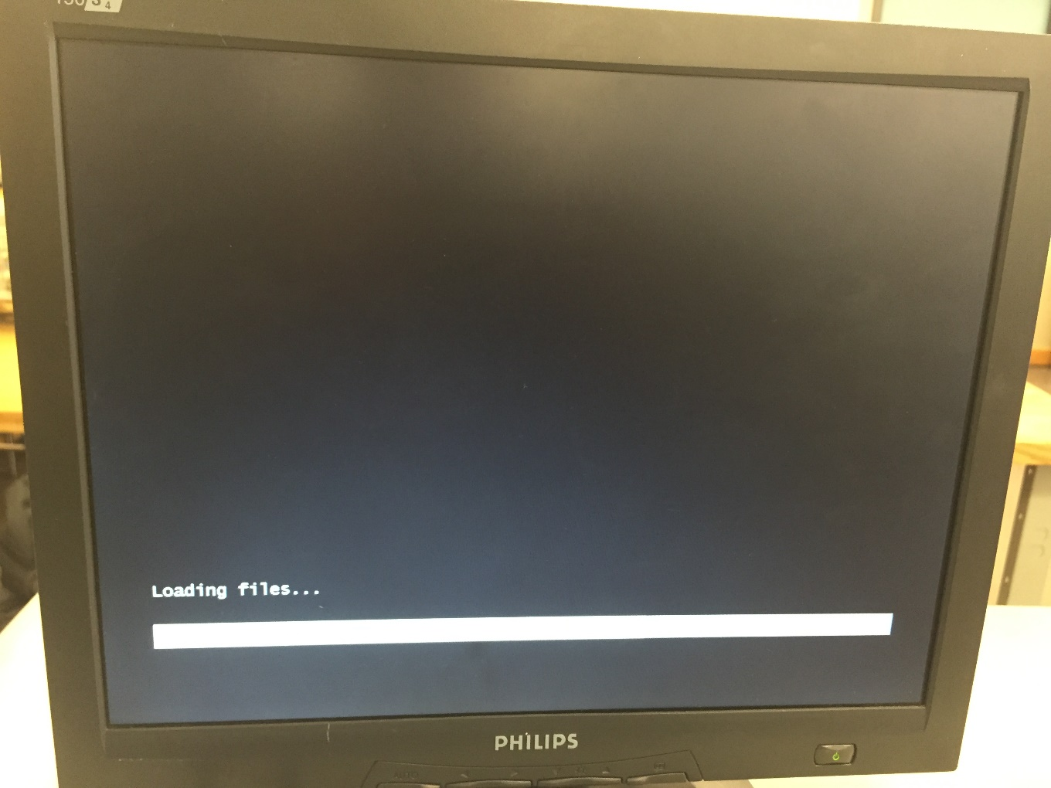
First of all insert windows server 2012 CD into your machine and start booting it.

Slide 3
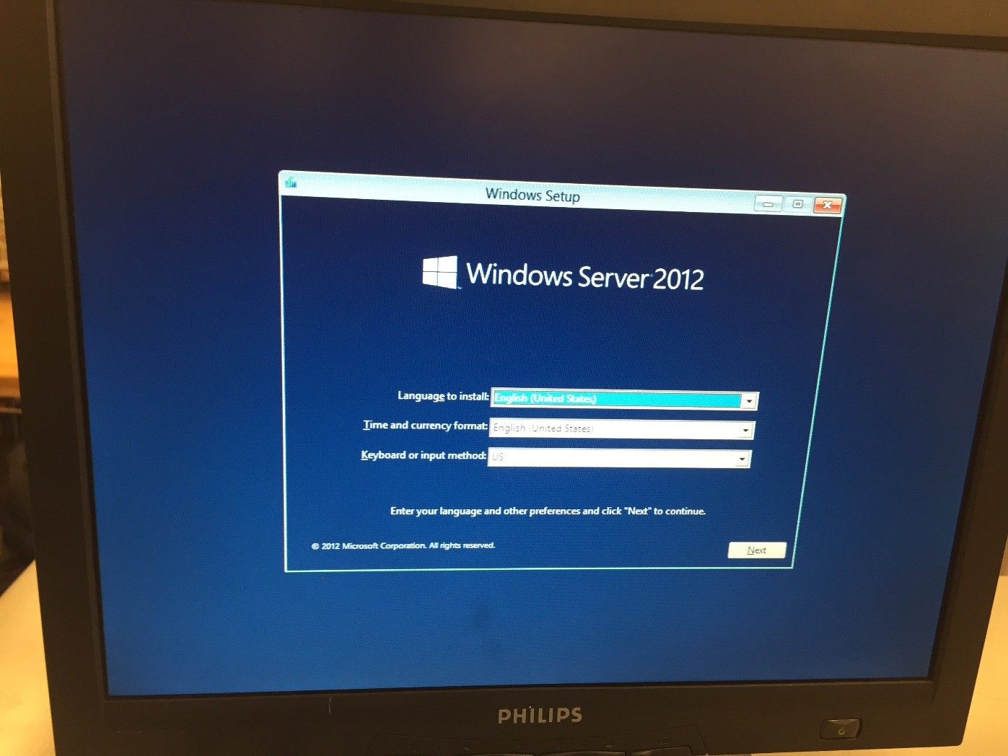
In windows setup dialogue box select your language and timezone.

Slide 4
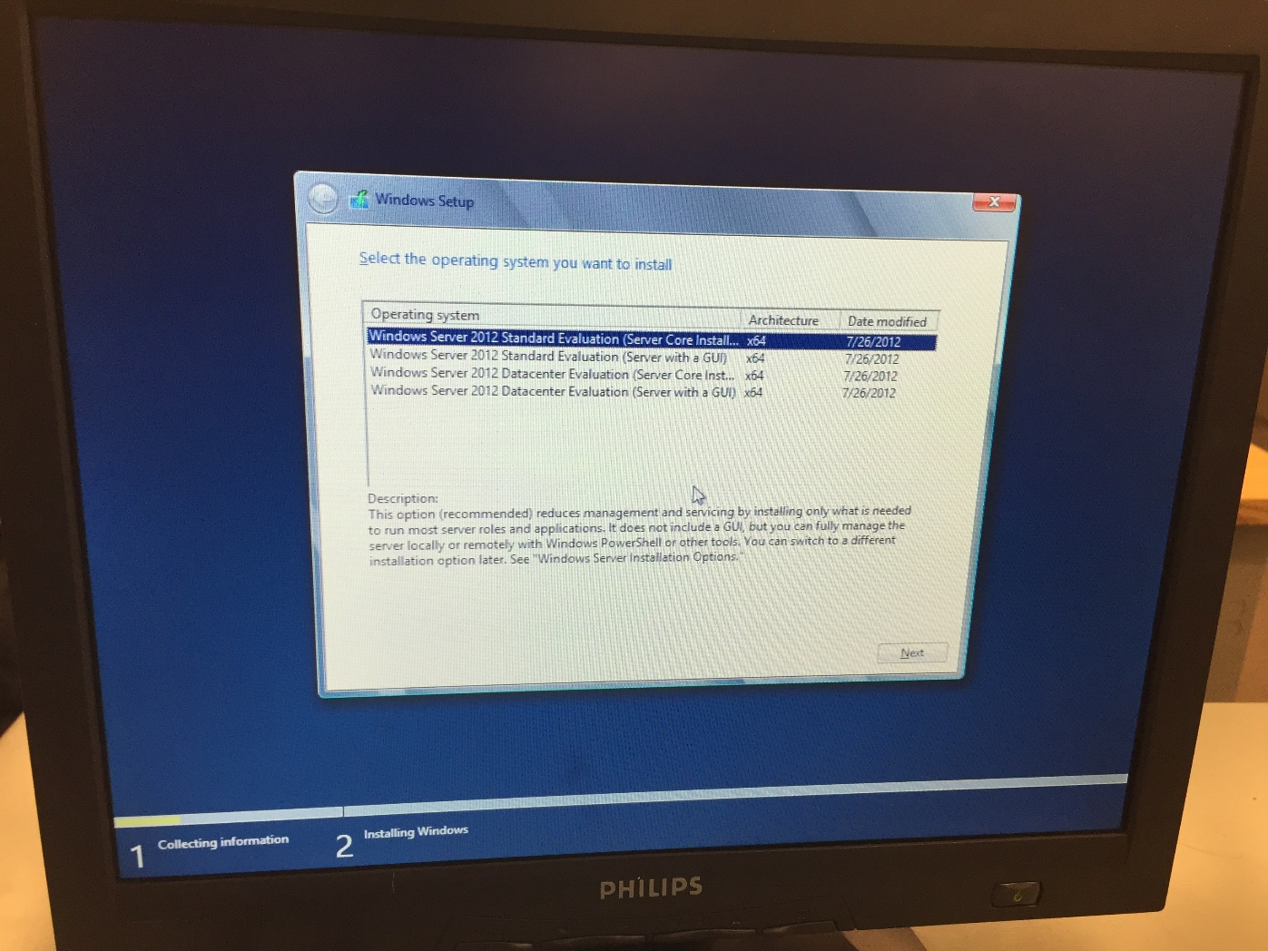
In operating system selection click on windows server2012 standard evaluation and then press next.

Slide 5
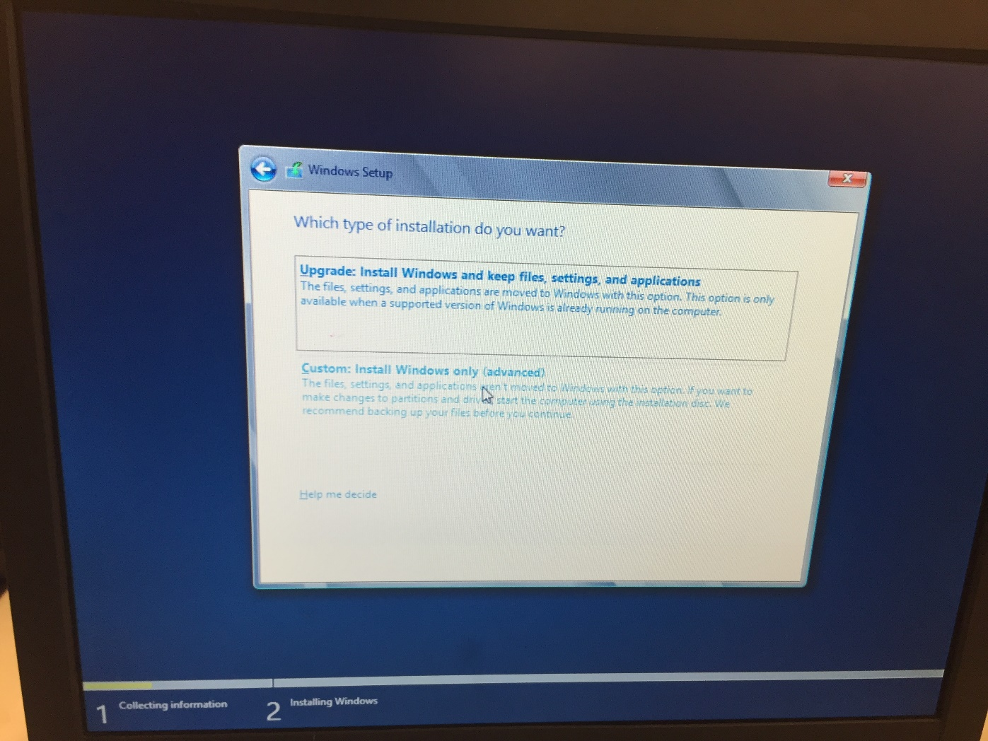
Then select custom installation to proceed.

Slide 6
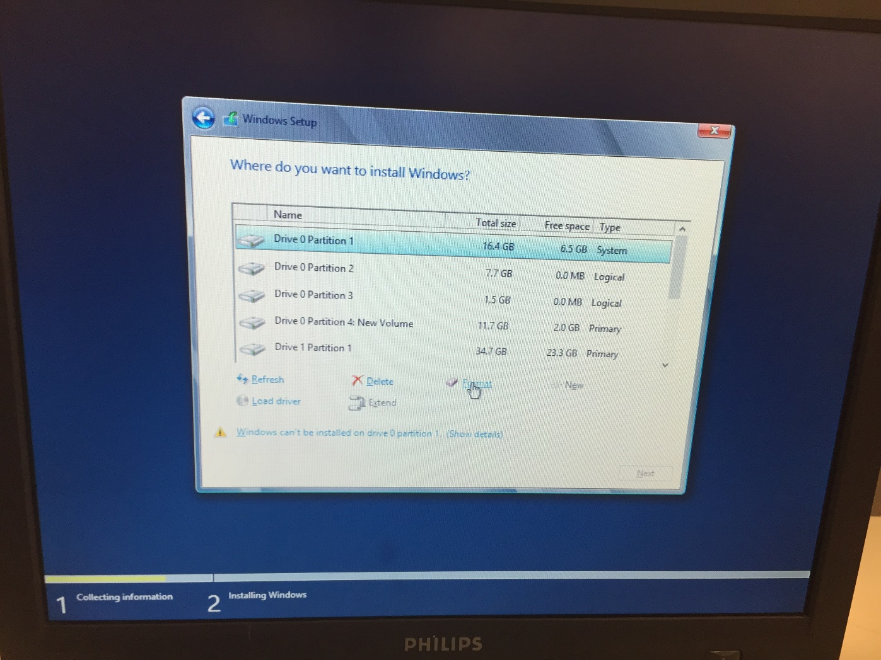
Then select the drive you want to install in server 2012 in or you can also create a new partition if you want.

Slide 7
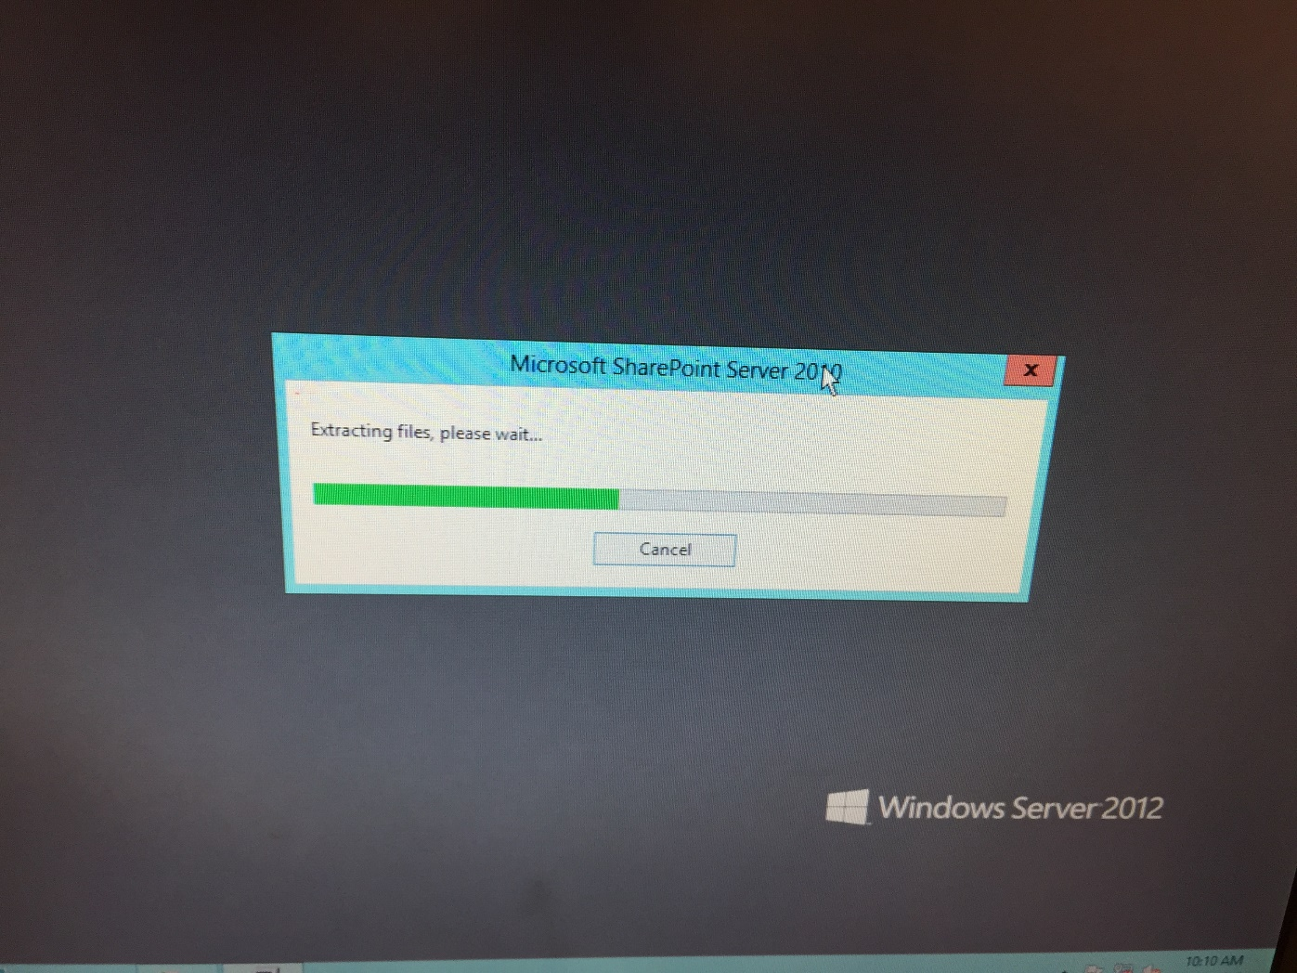
Upon installing windows server now start installing SharePoint 2010, you can install it from a CD or a setup in your Pc.

Slide 8
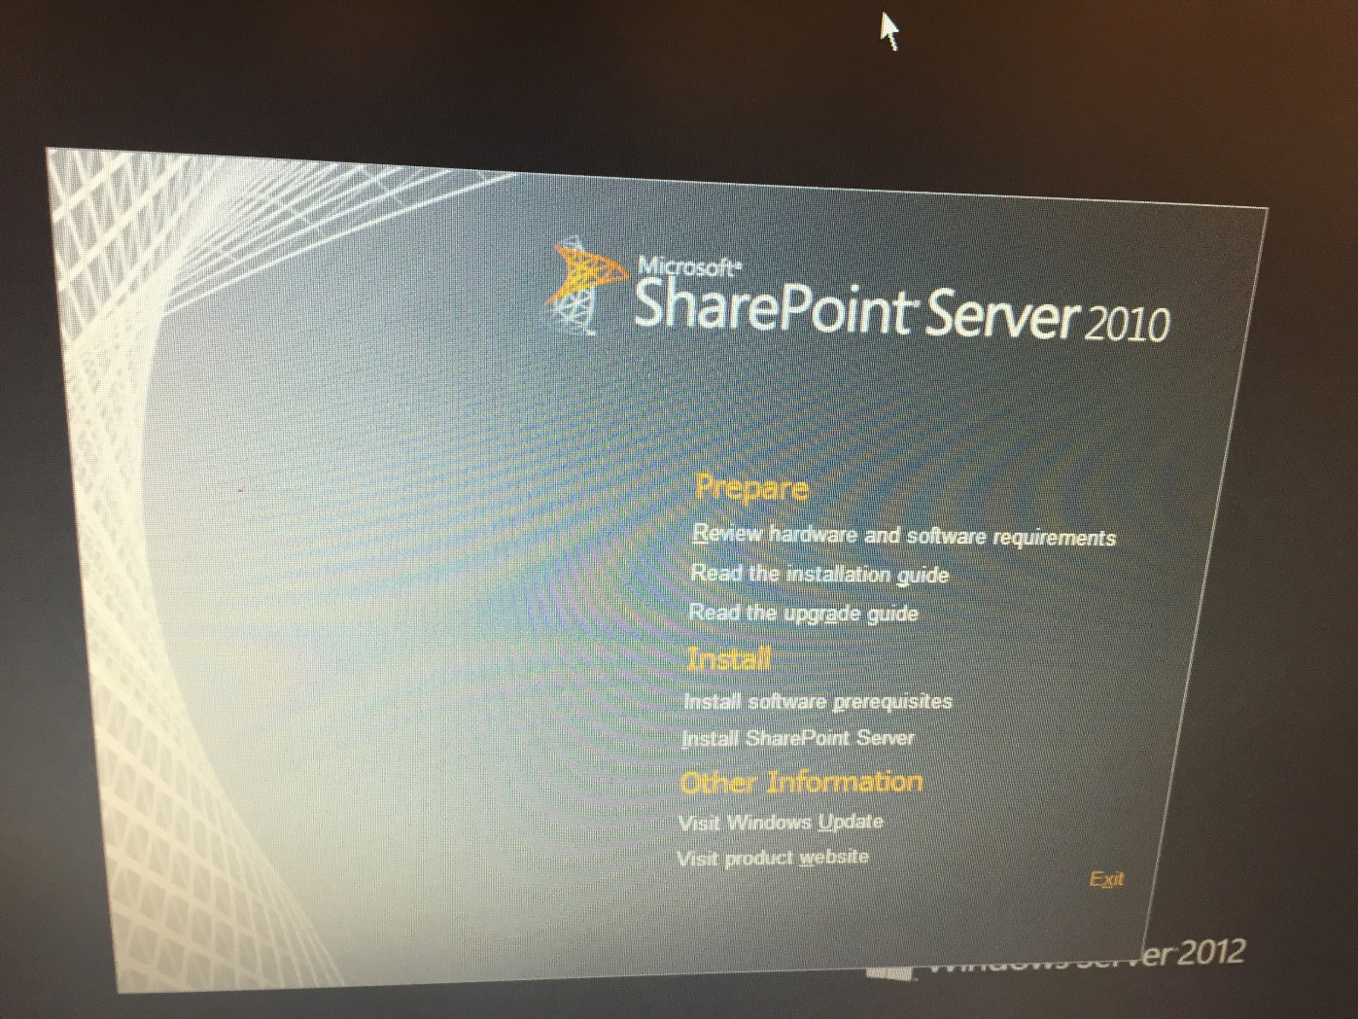
In installation window of SharePoint first you have to install software Prerequisites.

Slide 9
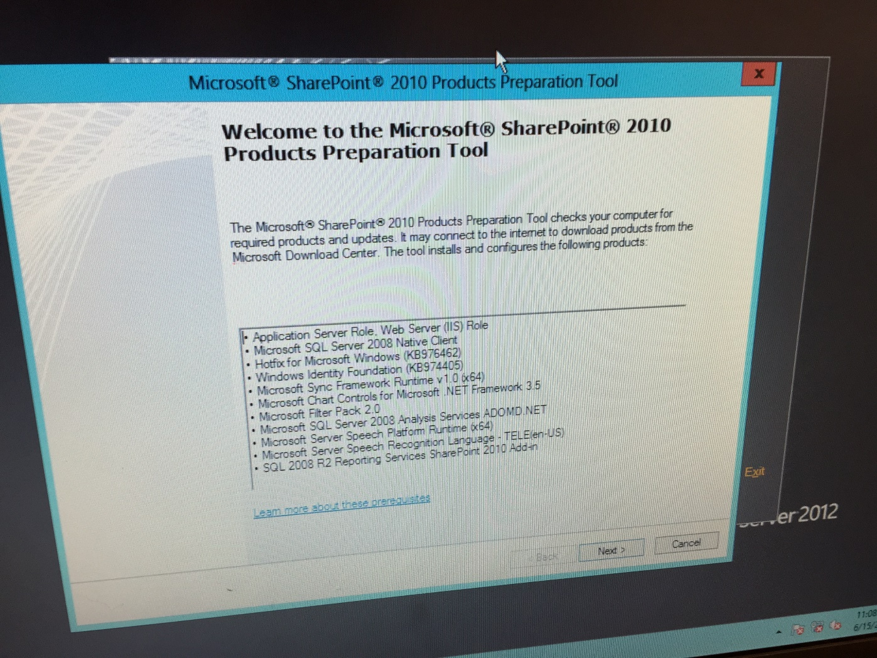
Click next to begin installing all prerequisites.

Slide 10
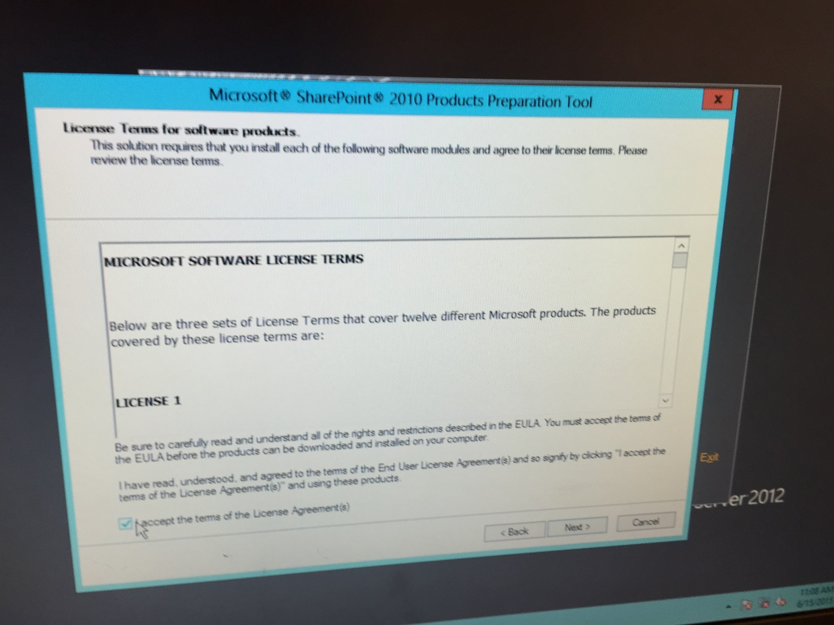
Then continue by pressing Next and agree to licence terms.

Slide 11
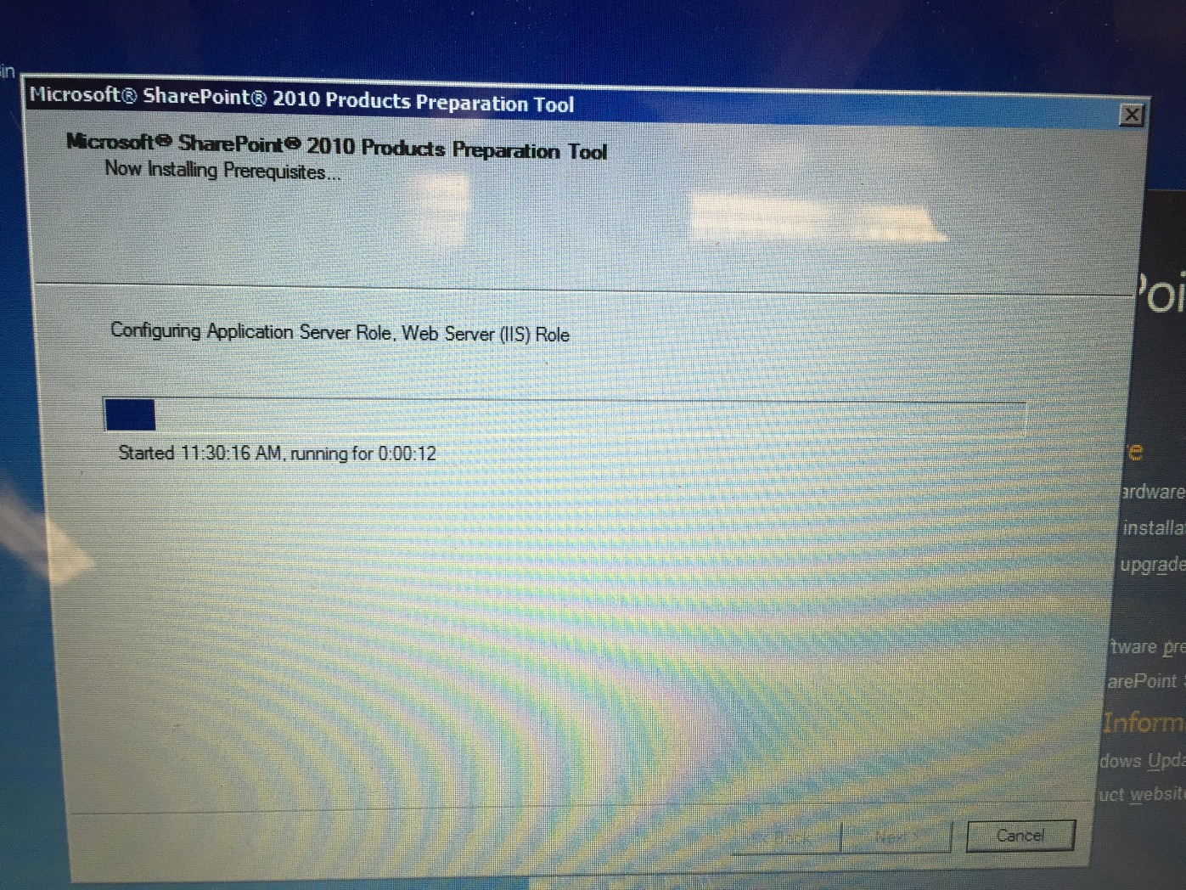
MS SharePoint 2010 will begin installing.

Slide 12
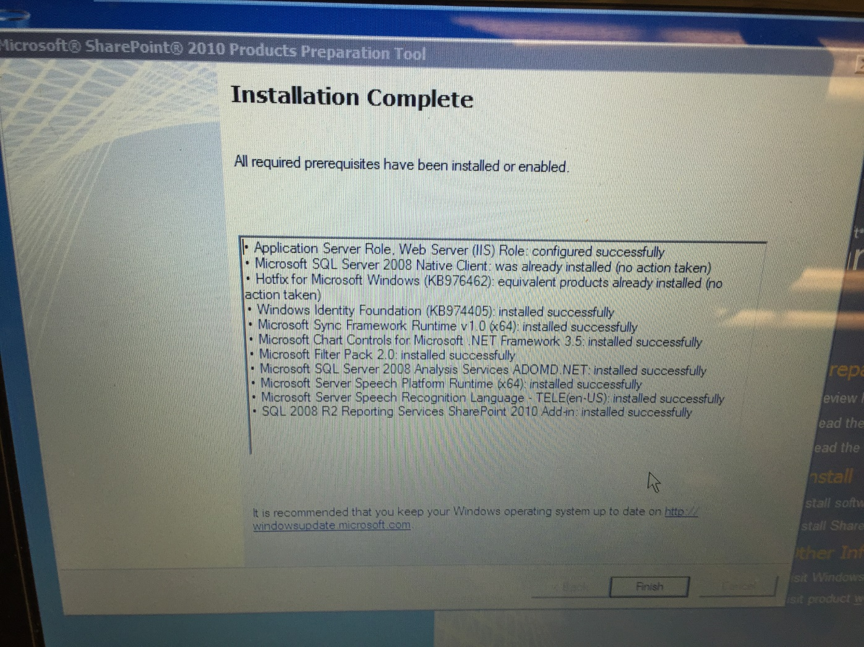
Click Finish to end installation, you will be prompted back to SharePoint 2010 installation window.

Slide 13
This time select Install SharePoint Server.

Slide 14
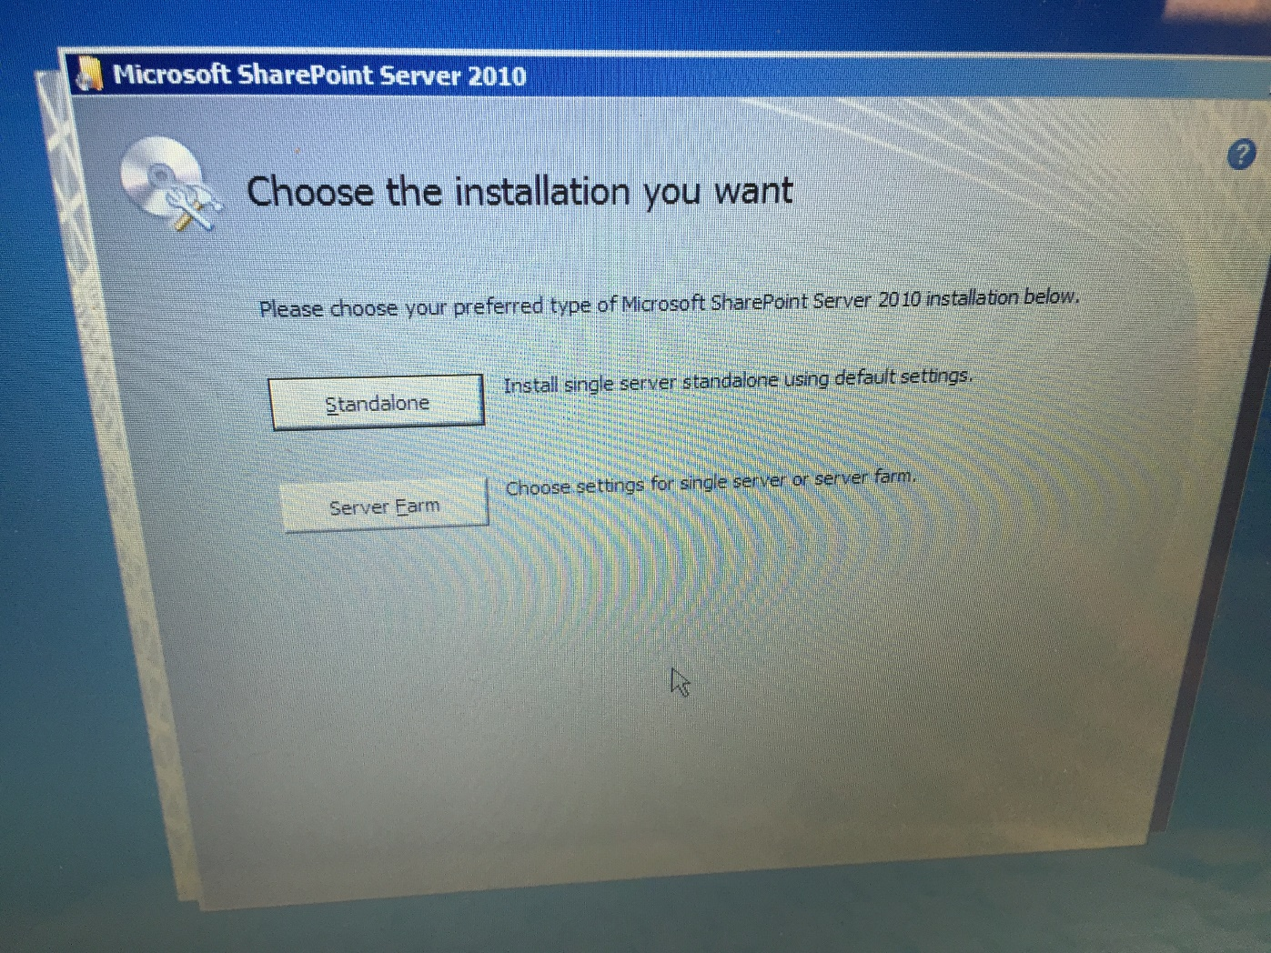
Select Standalone option.

Slide 15
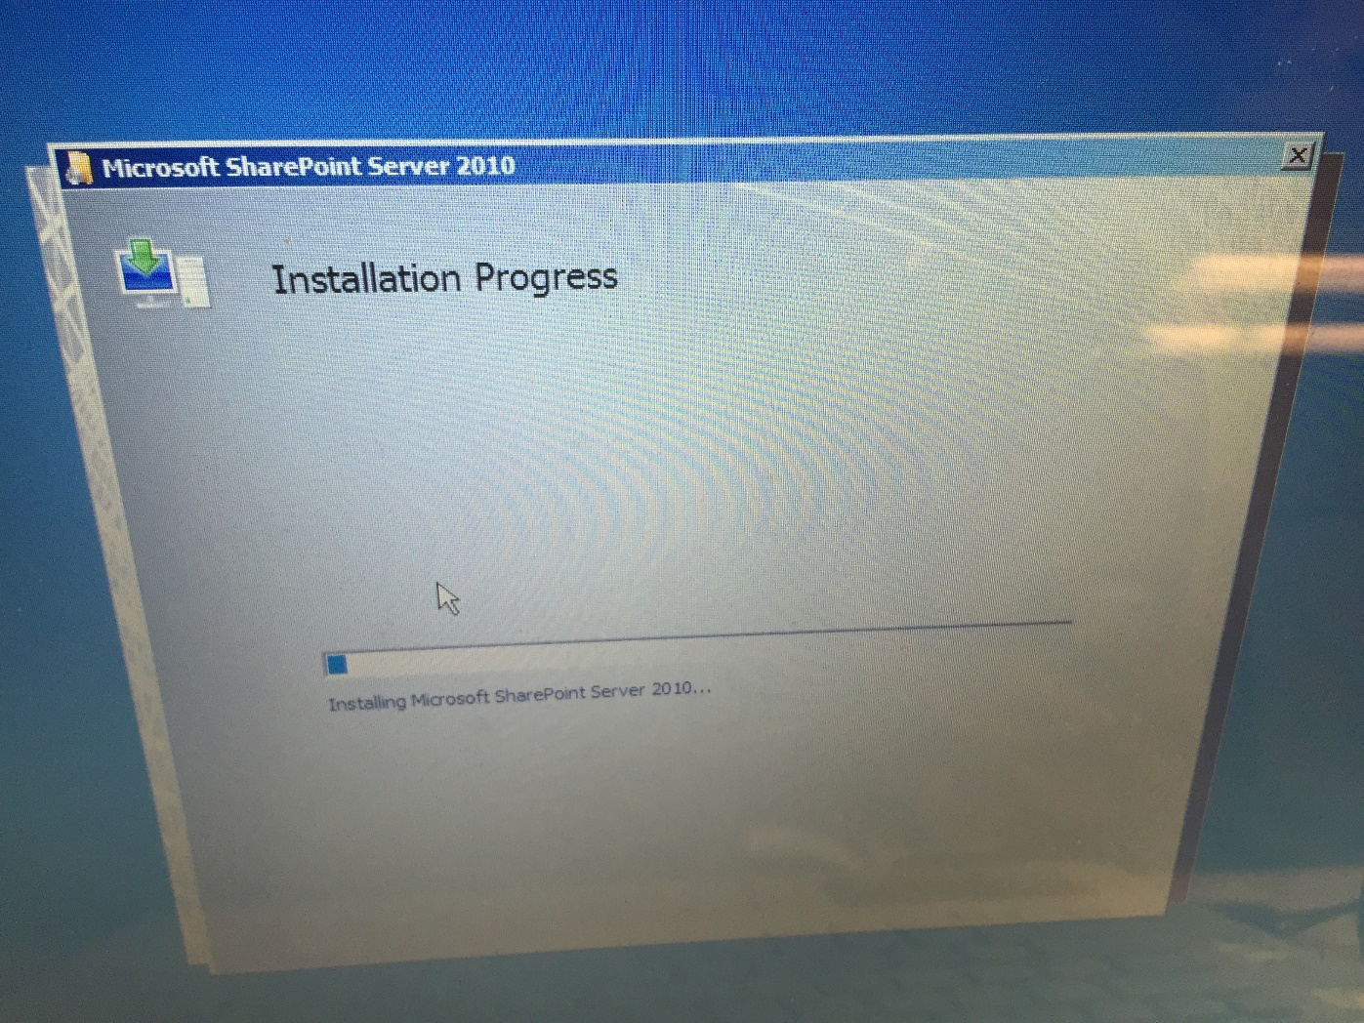
Your Installation process will begin.

Slide 16
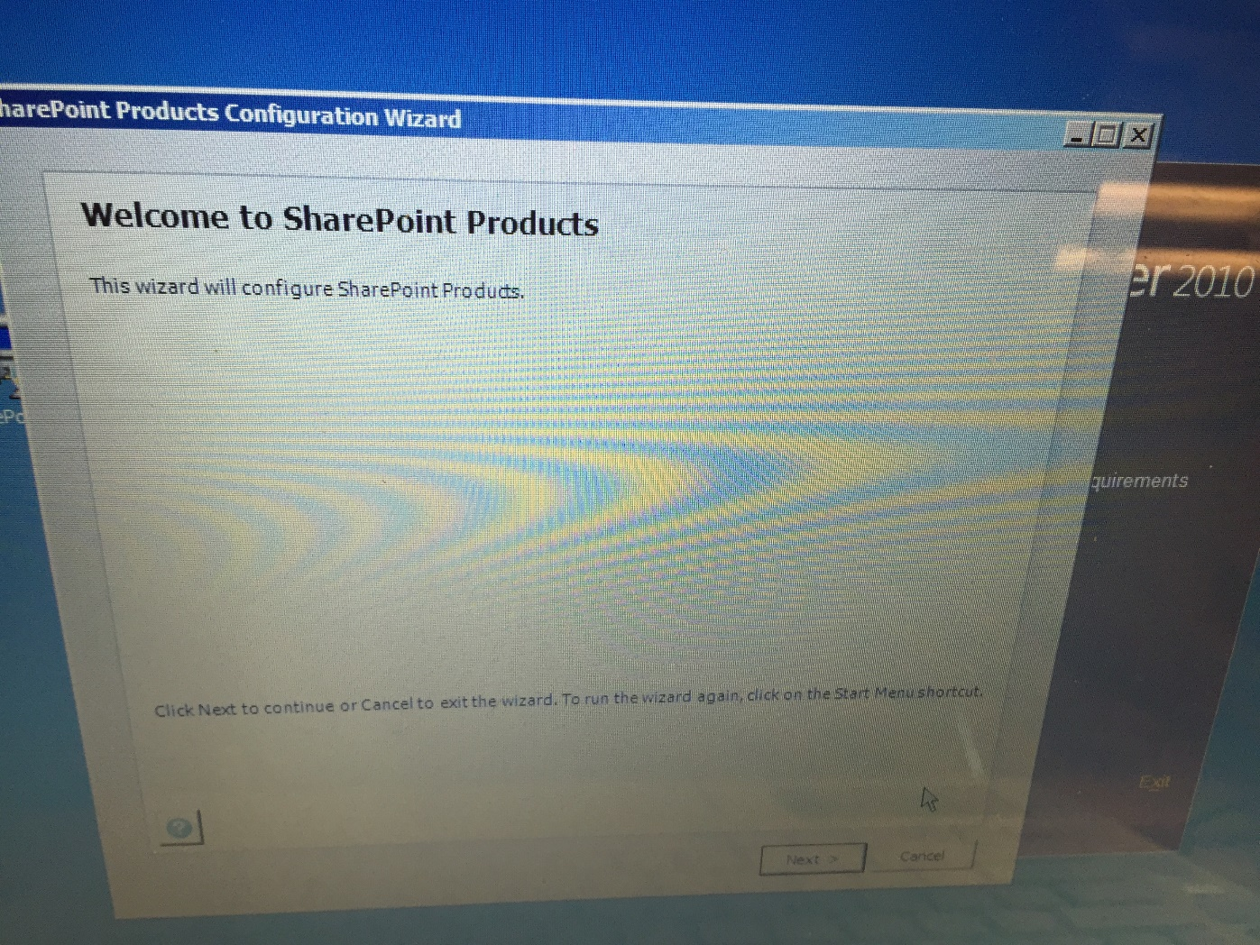
In SharePoint Configuration wizard press Next.

Slide 17
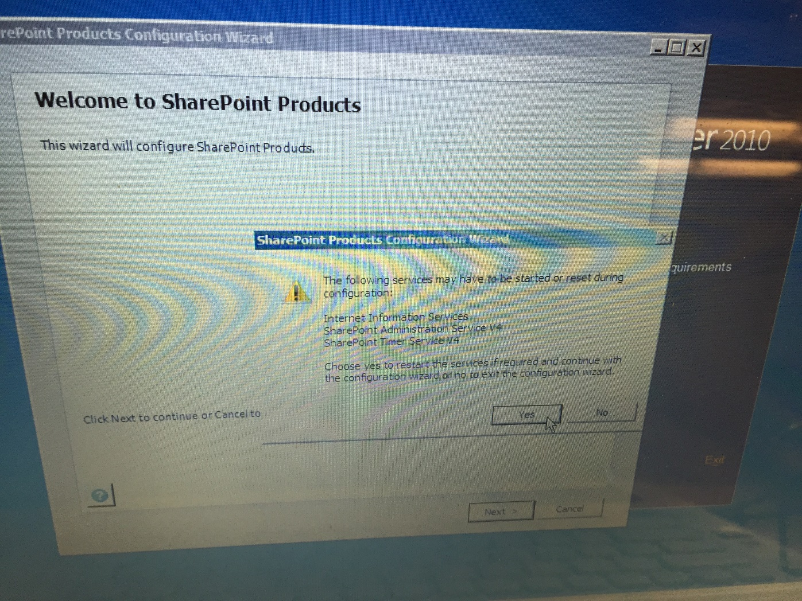
Press Yes on information message to begin Configuration.

Slide 18
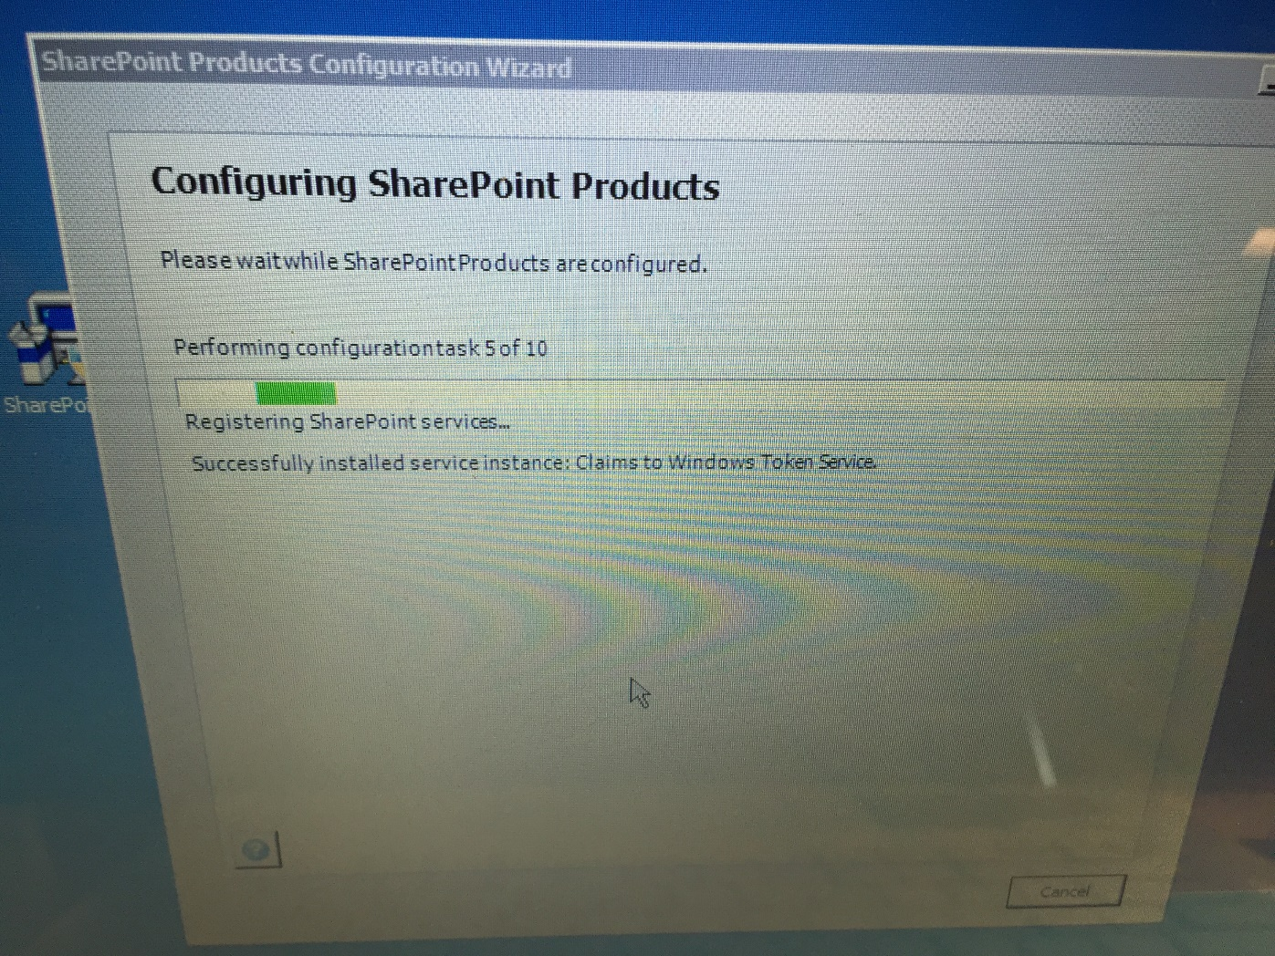
This will begin configuring SharePoint 2010 on your Pc.

Slide 19
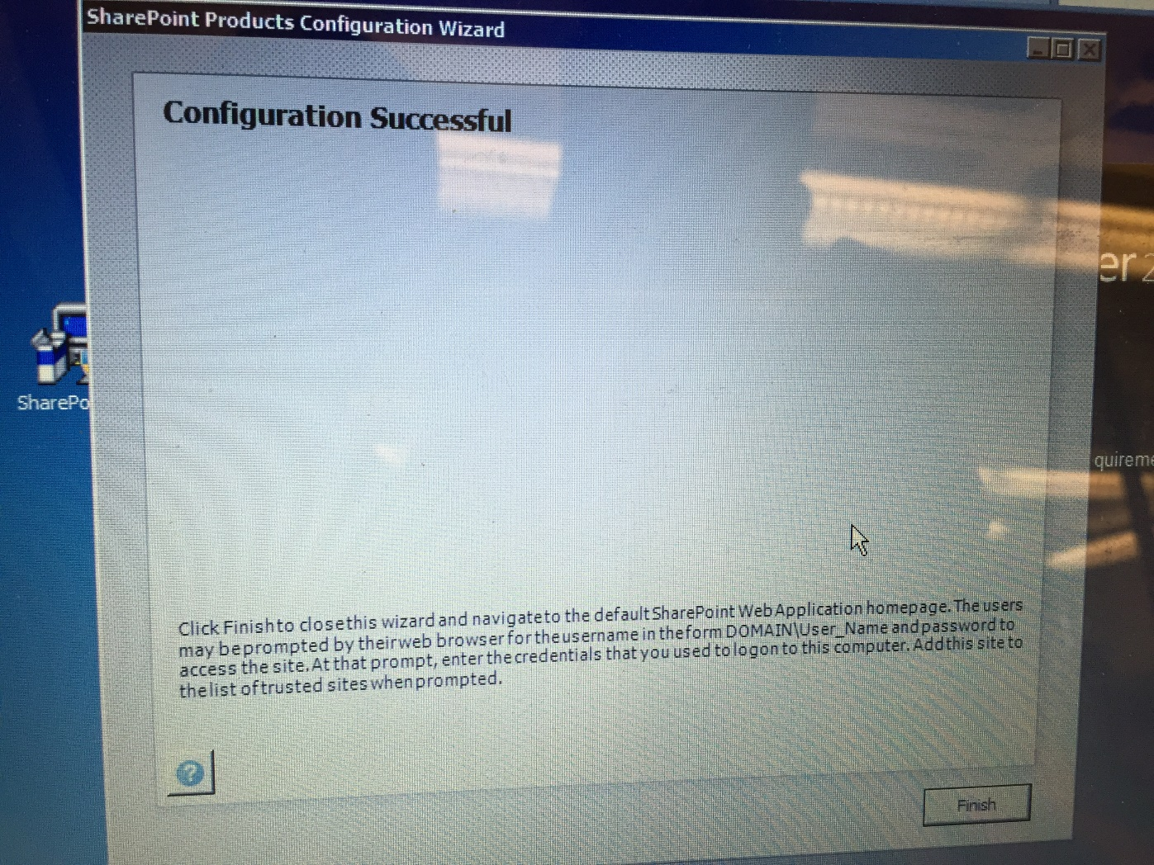
Press Finish to complete your Configuration process.

Slide 20
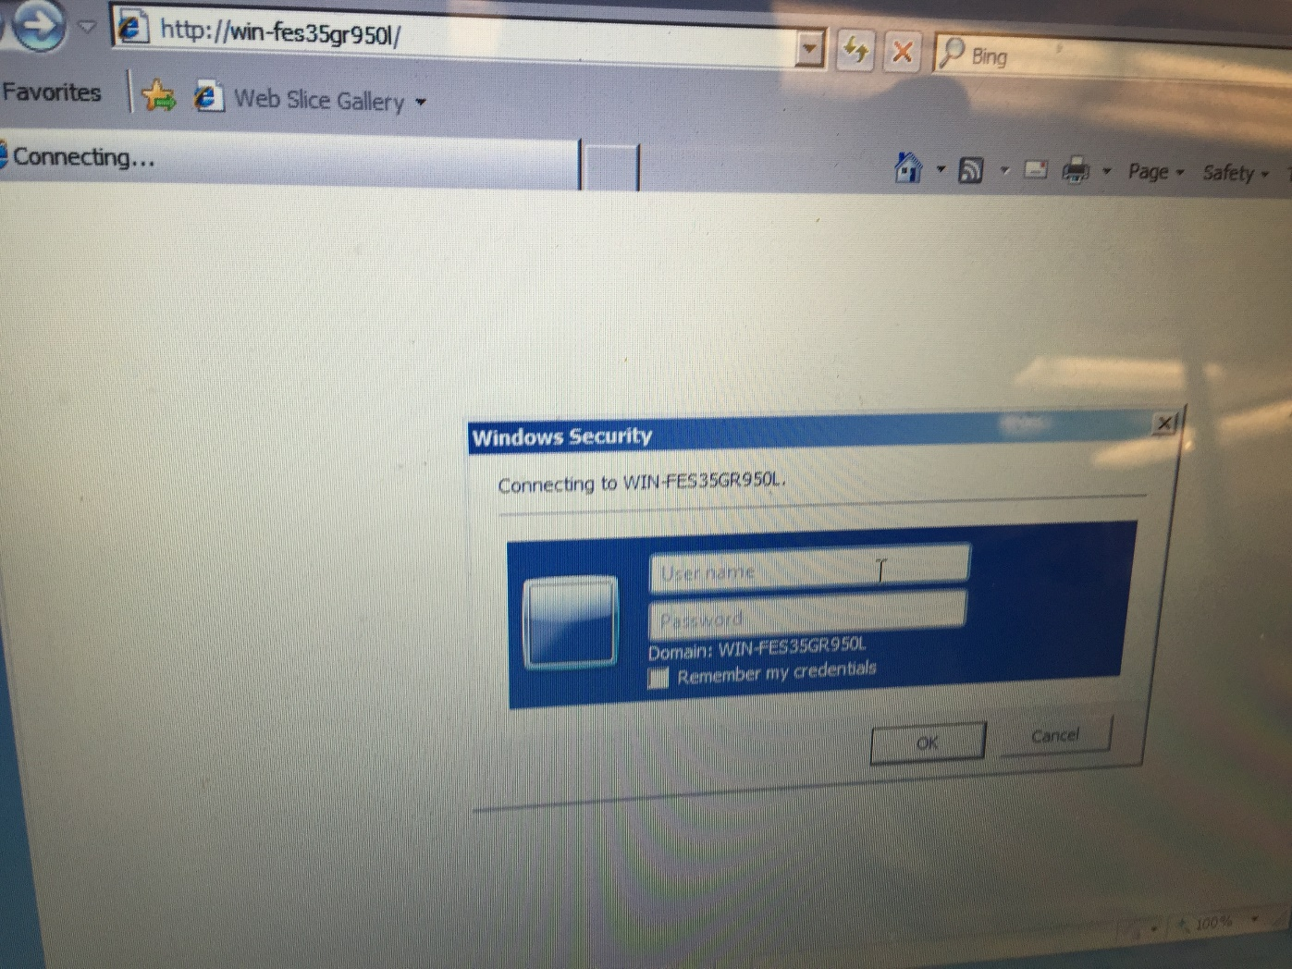
After this explorer will open you will be prompted to windows security box .

Slide 21
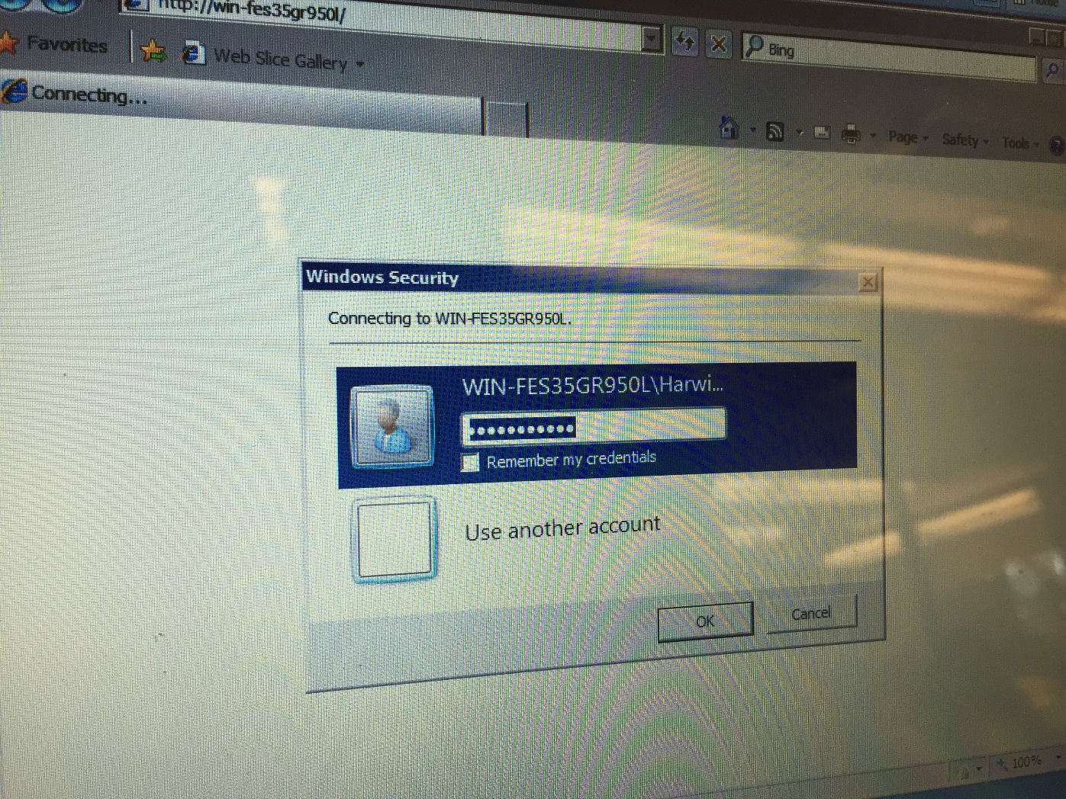
Here you will be asked to create a Password for your account.

Slide 22
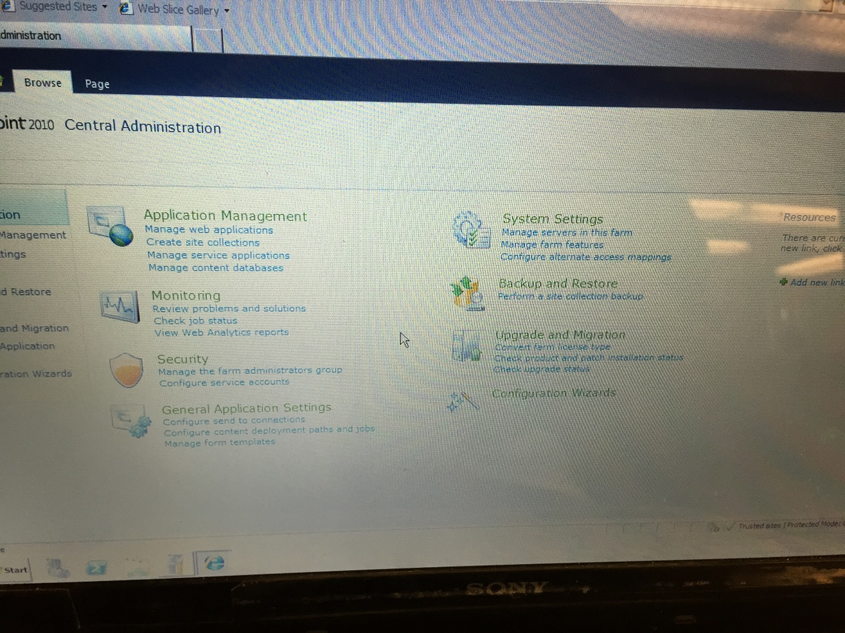
In Application Management click on Create Site Collection.

Slide 23
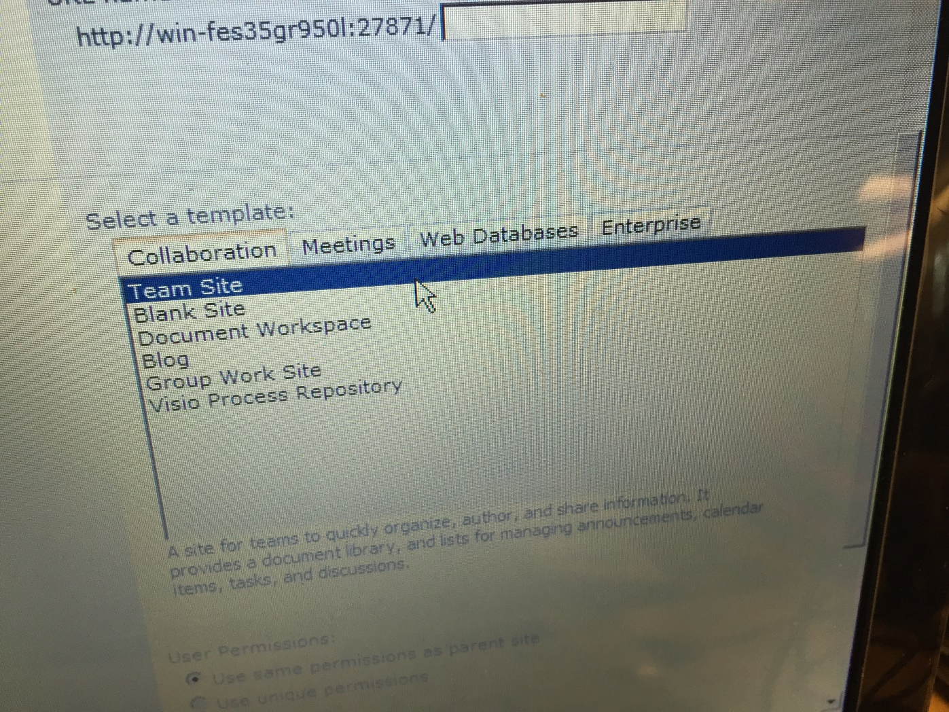
Then you need to select Team site Template.

Slide 24
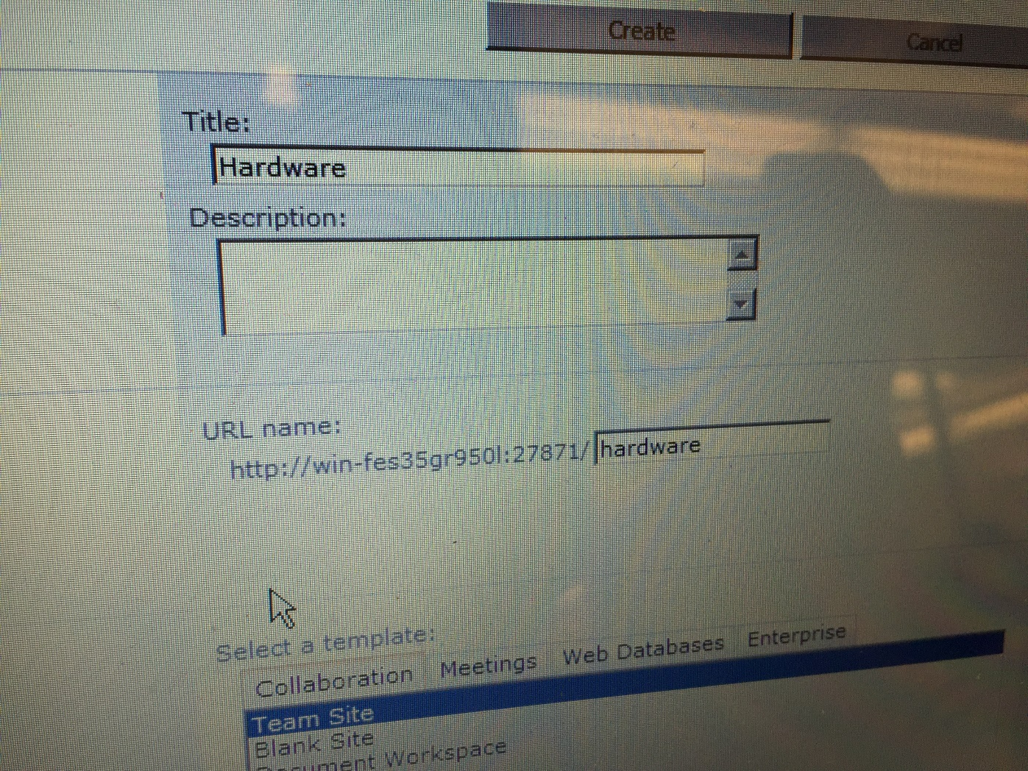
Now in Title field give a name to your site.

Slide 25
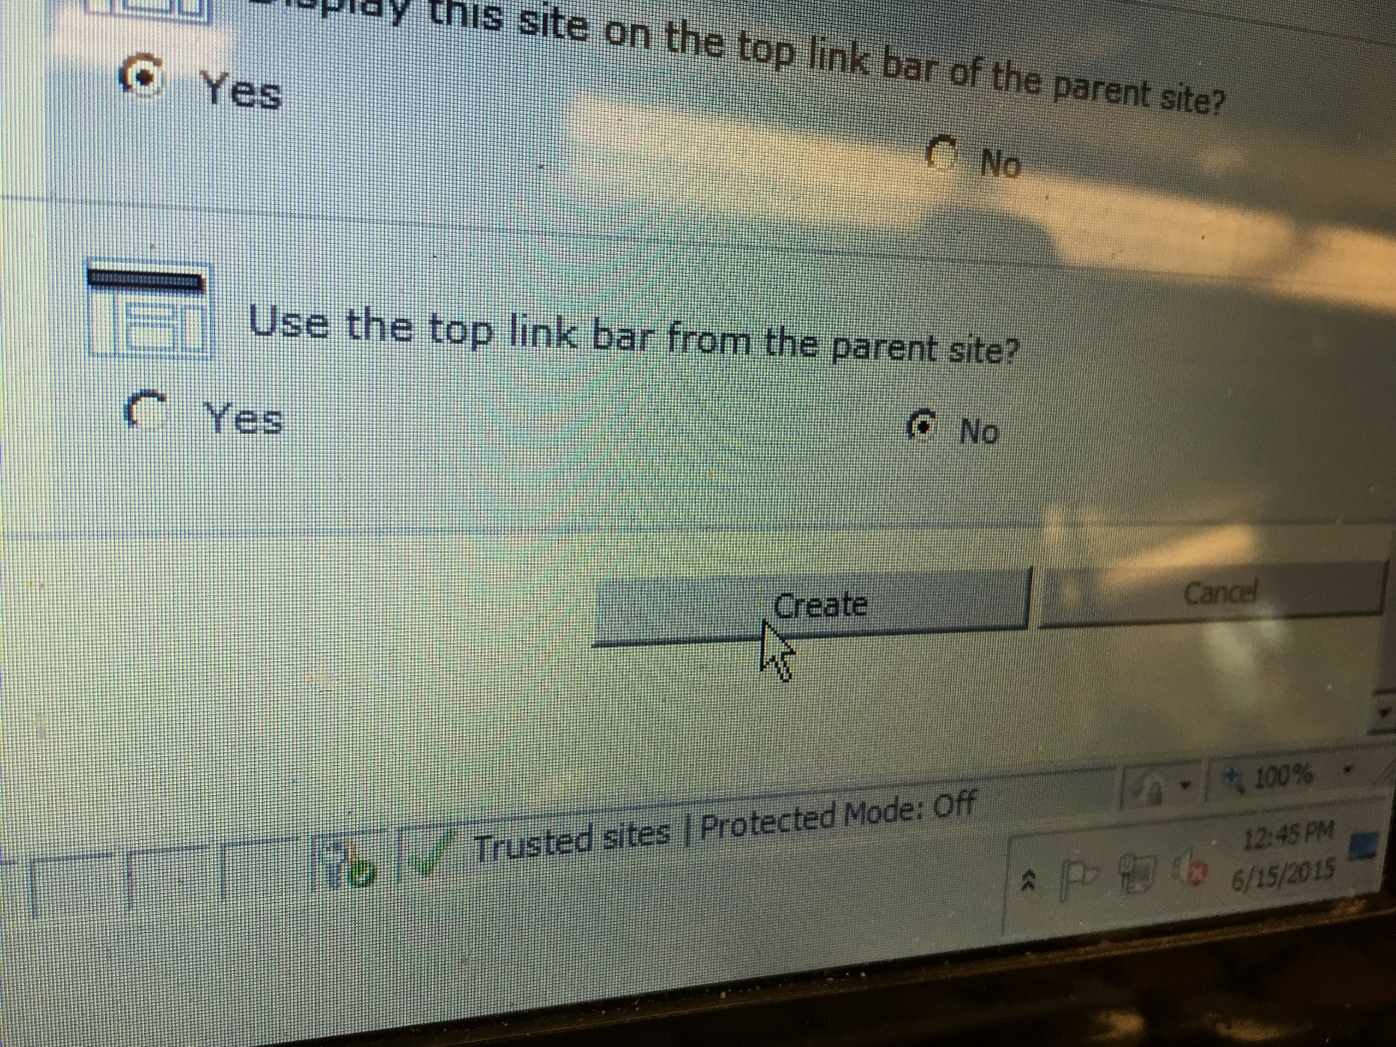
Click on create button to create your new site.

Slide 26
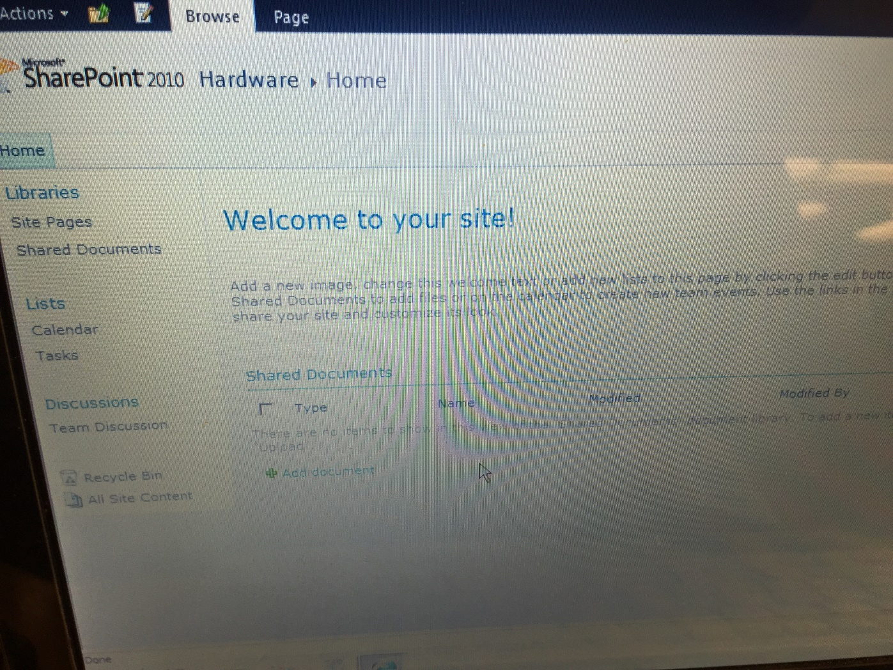
Now you will be able to create a new site in SharePoint.

